Slide 1
Working with OAuth
Robert Crooks

Slide 2
What is Oauth 2.0
Standard authentication system for RESTful APIs
Used by Google, Twitter, etc.
Used for all Brightcove’s new RESTful APIs

Slide 3
How does it work?
There are several OAuth “flows”
Brightcove currently uses one: the Client Credential flow
OAuth Service accepts server-side calls only (no CORS)
How it works:
You get client credentials for some combination of API operations
Use the OAuth UI or make an API call
The credentials are a client_id and client_secret
You use the client_id and client_secret to get an access_token from the OAuth service
access_tokens time out (currently in 5 minutes)
The access_token is used to authenticate the API call

Slide 4
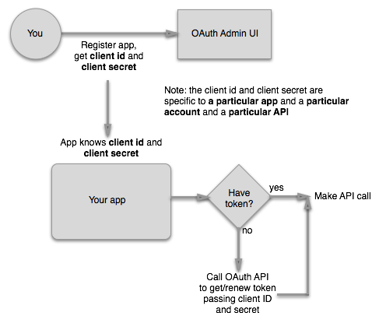
Client Credential Flow
This is the basic logic for using Oauth with your apps

Slide 5
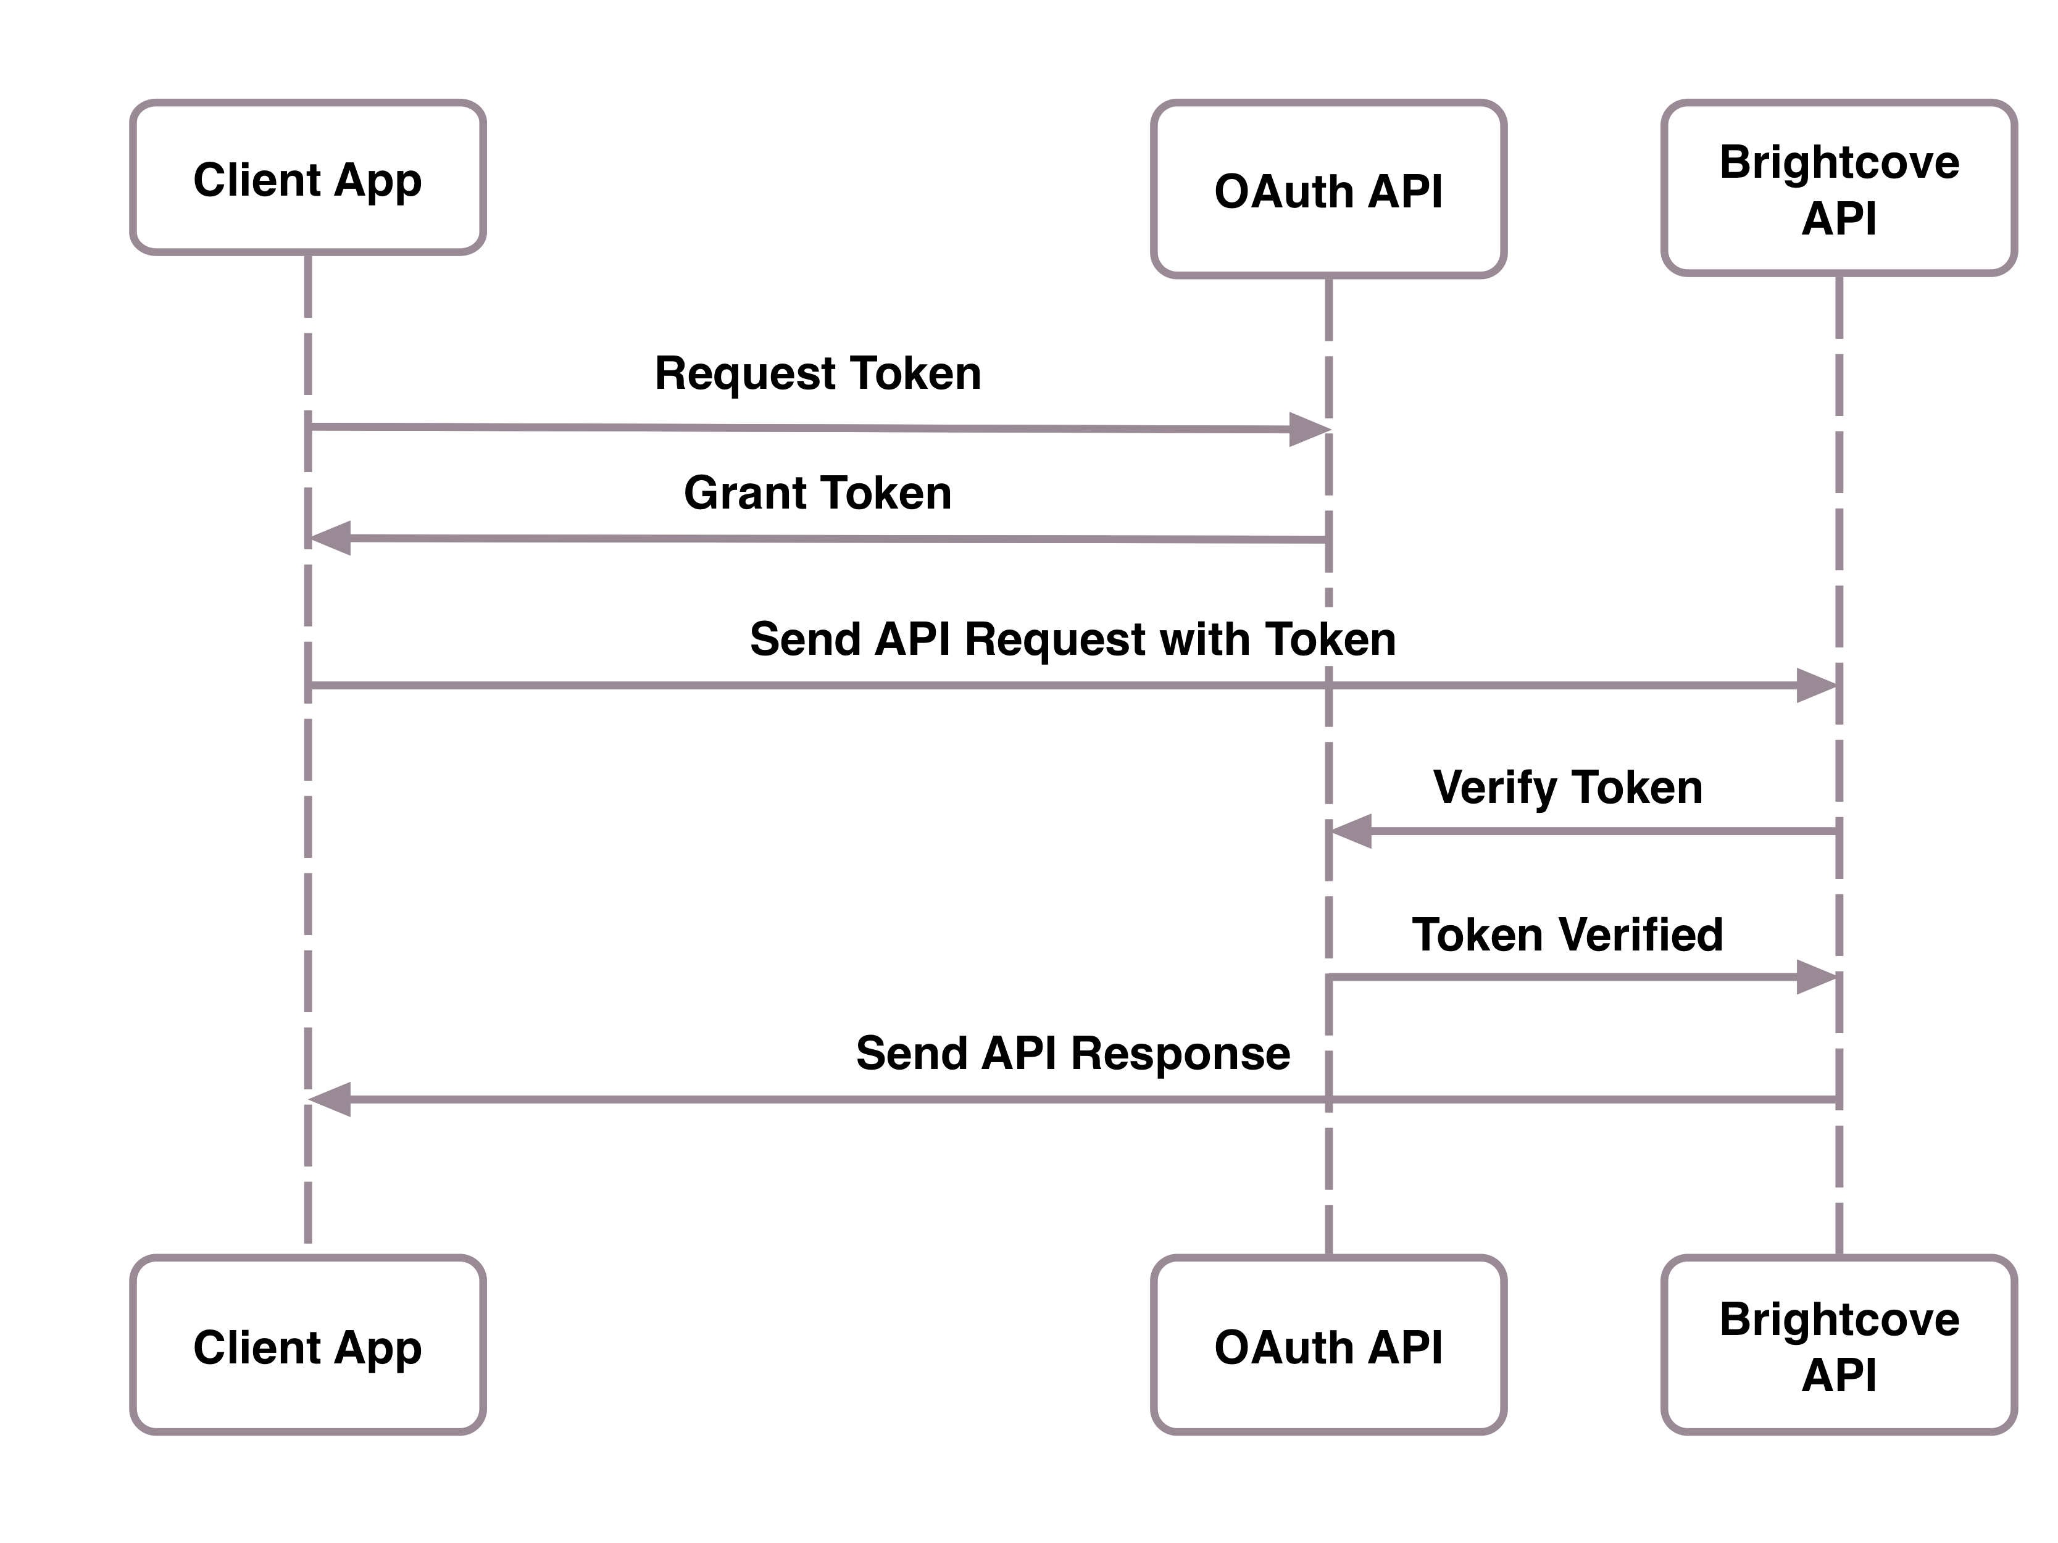
Sequence Diagram: One App
If you just building one server-side app, build the logic for getting tokens into the app

Slide 6
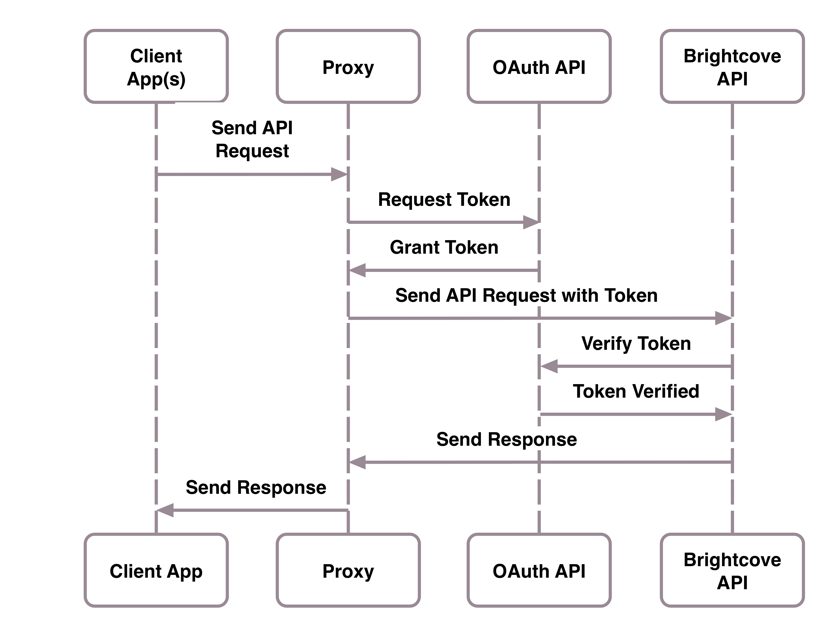
Sequence Diagram: Multiple Apps
If you are going to create multiple apps or a client-side app that will access an API, centralize the logic for getting access tokens in one place; one way to do this is to build a proxy for the API calls

Slide 7
Getting Client Credentials

Slide 8
What You Need
Access to the OAuth UI in Studio
But note that not all API operations are there yet
Alternatively, make an API call to the OAuth API
You will need your BC_TOKEN
You will also need the operations you want access to
Get the BC_TOKEN from browser cookies
You must be in Studio
You must be in the account you want to use the API on
Save the client_id and client_secret where you can find them!

Slide 9
Hands-on: Get Client Credentials
In this exercise, we will make a call to the OAuth API to get client credentials for the CMS API
What you will need:
Files for the exercises: http://files.brightcove.com/oauth-exercises.zip
A browser to access Studio
Ability to run CURL commands (native on Macs; for Windows, you can get these tools by installing cygwin. During the install you will be prompted for packages to install. Open the Net package, then check the curl option and then finish the installation.)

Slide 10
Get Your BC_TOKEN
Login to Brightcove Studio
Open the Developer Console in your browser
Paste the following lines of JavaScript at the console prompt and press Return (this code is in JavaScript.js):
var cookiesArray = document.cookie.split(";"), cookiesObj = {}, i, tmpArray = [];
for (i = 0; i < cookiesArray.length; i++) {
tmpArray = cookiesArray[i].split("=");
cookiesObj[tmpArray[0].replace(/\s/g, "")] = tmpArray[1];
}
window.prompt("BC_TOKEN:", cookiesObj.BC_TOKEN);
You should see your BC_TOKEN cookie appear in a popup dialog; copy and save it for the next step.

Slide 11
Get Your Access Credentials
Go to a command line and paste in the following CURL command (the code is in curl.txt):
curl \
--include \
--header "Authorization: BC_TOKEN Your_BC_TOKEN_HERE" \
--data 'name=SampleClient&maximum_scope=[{
"identity": {
"type": "video-cloud-account",
"account-id": YOUR_ACCOUNT_ID
},
"operations": [
"video-cloud/video/all"
]
}]' \
https://oauth.brightcove.com/v3/client_credentials
Copy the client_id and client_secret and save them for use in the next exercise.

Slide 12
Make an API Call

